Slide 1


Data
Analytics
Notes:
null
null

Slide 2


Today's Agenda
Project recap
To provide a high-level overview of the business problem were tackling and the precise requirements, we will provide a summary of the entre project
Problem
We will get into the particular issue that the Data Analytics team has been concentrating on and provide some context for why this is such a significant issue
The Analytics team
It start by outlining the issue and then discuss the team that is in charge of handling this assignment on our end
Process
After that, I'll go into the general steps we look to do this assignment so you can fully understand how we approach tasks of this nabre
Insights & Summery
Lastly, I will review all significant findings and offer them as a collection of understandings and illustrations
Notes:
null
null

Slide 3

Social Buzz is a fast growing technology unicorn that need to adapt quickly to it's global scale. Accenture has begun a 3 month POC focusing on these tasks:
• An audit of Social Buzz's big data practice
• Recommendations for a successful IPO
• Analysis to find Social Buzz's top 5 most popular categories of content
Project Recap
Notes:
null
null

Slide 4

Problem
Over 100000 posts per day
36,500,000 pieces of content per year!
But how to capitalize on it when there is so much?
Analysis to find Social Buzz's top 5 most popular categories of content
Notes:
null
null

Slide 5



Andrew Fleming
Chief Technical Architect
The Analytics team
Marcus Rompton
Senior Principle
Kalyani Anna
Data Analyst
Notes:
null
null

Slide 6
Process
1
Data Understanding
2
Data Cleaning
3
Data Modelling
4
Data Analysis
5
Uncover Insights
Notes:
null
null

Slide 7

Insights
Categories With Highest score
Unique Categories
Month with most posts
16
75K
May
Animals

Slide 8
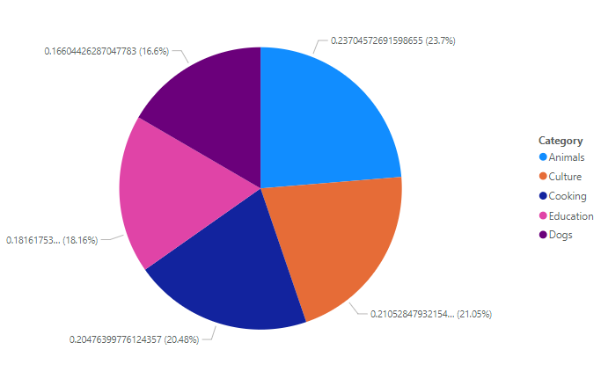
Insights : Top 5 catogaries
Notes:
null
null

Slide 9


The project involves creating a big data presentation for Social Buzz, providing hands-on support for their upcoming IPO.
The team will analyze sample datasets, audit their data center, conduct a technology workshop, stress-test their technology, hold a virtual session, and create a comprehensive best practices document.
Summary
Notes:
null
null

Slide 10
Thank you!
ANY QUESTIONS?
Notes:
null
null

